Slide 1
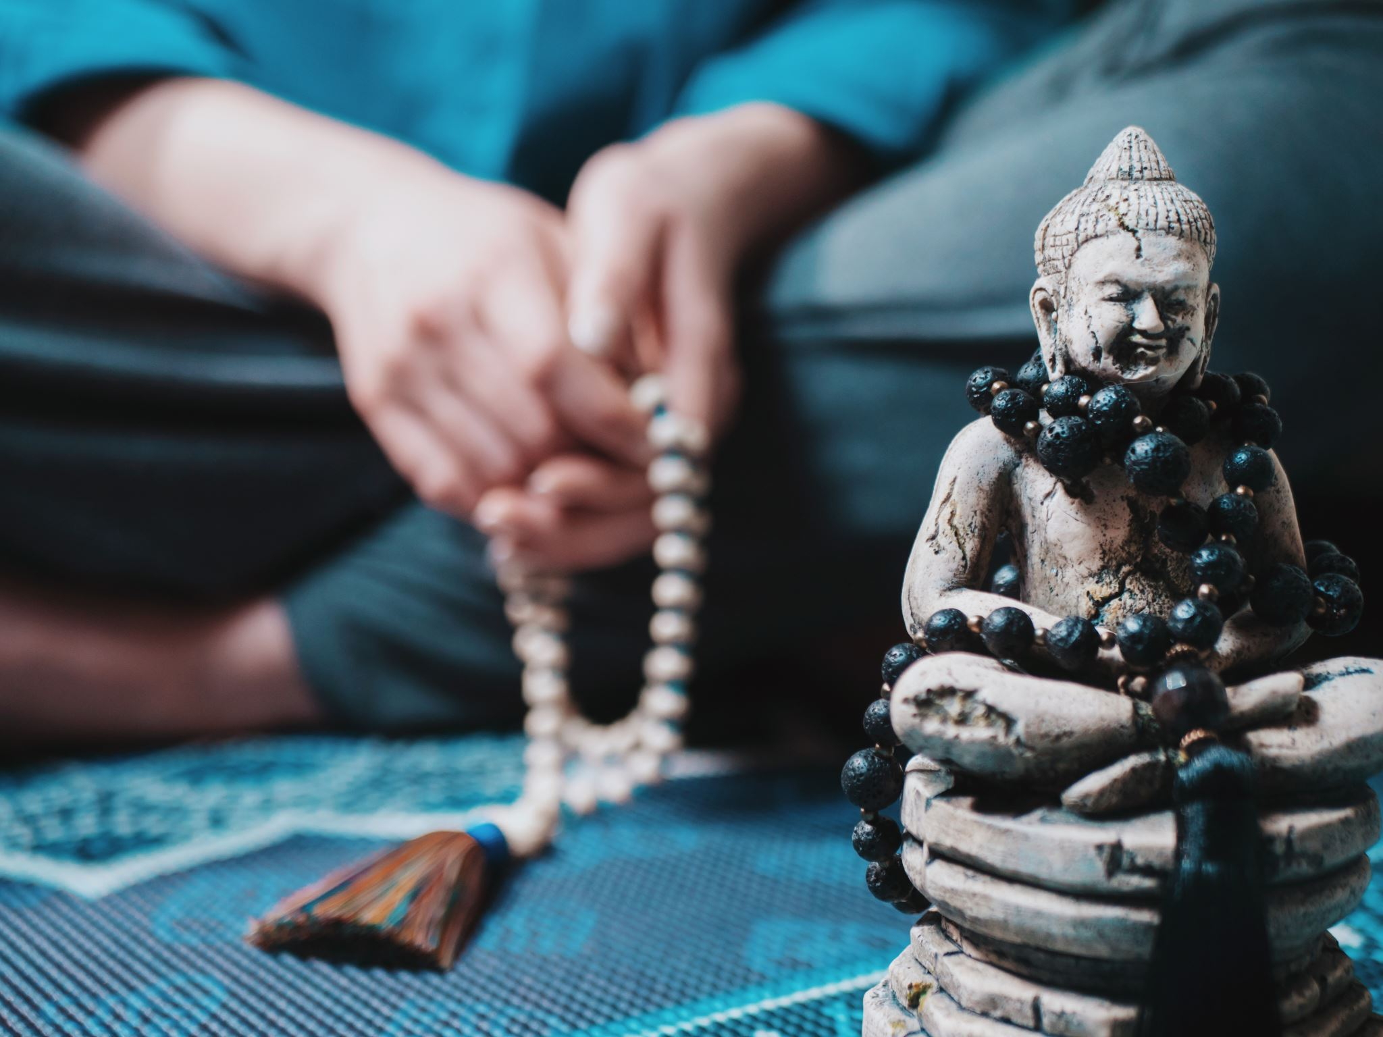
Samsarin to Sadhaka: A Journey of Spiritual Transformation

Slide 2


Introduction
Welcome!

Slide 3

Samsara, the cycle of birth, death, and rebirth, is a fundamental concept in Eastern philosophies

Slide 4
History
he historical origins of a concept of a cycle of repeated reincarnation or Punarjanman are obscure but the idea appears in texts of both India and ancient Greece during the first millennium BC
The idea of saṃsāra is hinted in the late Vedic texts such as the Rigveda, but the theory is absent
According to Sayers, the earliest layers of the Vedic literature show ancestor worship and rites such as sraddha

Slide 5
Understanding Samsara
Attachment to Material Possessions: A Samsarin tends to be strongly attached to material possessions and external achievements
Identification with the Ego: A Samsarin identifies strongly with the ego, the sense of individuality and separateness
Pursuit of Worldly Desires: A Samsarin is driven by desires for sensory pleasures, worldly achievements, and personal gratification
Ignorance of the True Nature of Reality: A Samsarin is often unaware of the deeper aspects of existence and the true nature of reality
Experiences of Suffering: Samsarins experience the ups and downs of life, including various forms of suffering

Slide 6

Characteristics of a Samsarin
Attachment to Material Possessions: A Samsarin tends to be strongly attached to material possessions and external achievements
Identification with the Ego: A Samsarin identifies strongly with the ego, the sense of individuality and separateness
Pursuit of Worldly Desires: A Samsarin is driven by desires for sensory pleasures, worldly achievements, and personal gratification
Ignorance of the True Nature of Reality: A Samsarin is often unaware of the deeper aspects of existence and the true nature of reality
Experiences of Suffering: Samsarins experience the ups and downs of life, including various forms of suffering

Slide 7

The Role of Desire and Attachment
Attachment to Desires: Desire arises from the human tendency to seek pleasure and fulfillment
Identification with the Ego: Desire and attachment are closely linked to the identification with the ego, the sense of individuality and separateness
Illusion of Permanence and Fulfillment: Desire and attachment stem from the mistaken belief that the fulfillment of desires will bring lasting happiness and fulfillment
Accumulation of Karma: Every desire and attachment generates karma, the accumulation of actions and intentions

Slide 8

Introduction to Sadhaka
A Sadhaka is an earnest seeker of spiritual growth and self-realization

Slide 9
Sadhaka
A sādhaka or sādhak or sādhaj (Sanskrit: साधक), in Indian religions and traditions, such as Jainism, Buddhism, Hinduism and Yoga, is someone who follows a particular sādhanā, or a way of life designed to realize the goal of one's ultimate ideal, whether it is merging with one's eternal source, brahman, or realization of one's personal deity.
Purpose of Sadhana: The primary purpose of Sadhana is to transcend the limitations of the ego and the material world, and to establish a deep connection with the divine essence within oneself and in the universe
Types of Sadhana: Sadhana encompasses a wide range of spiritual practices, Brahma sadhana, dhyana dharana, incantation and hymns, idol worship.
Explore specific practices that aid in the transformation from Samsarin to Sadhaka
Highlight the benefits and purpose of these practices

Slide 10

Benefits of the Sadhaka's Path
Inner Peace: One of the primary benefits of Sadhana is the cultivation of inner peace
Expanded Awareness: Sadhana helps expand one's awareness beyond the limited perceptions of the ego
Emotional Well-being: The Sadhaka's path can lead to emotional healing and well-being
Self-Discovery and Self-Realization: Sadhana facilitates self-discovery, enabling the Sadhaka to explore and understand their true nature beyond the limitations of the ego
The path of transformation is not without its challenges

Slide 11
Integration of Spiritual Practice
Awareness and Mindfulness: Integration begins with cultivating awareness and mindfulness in daily life
Alignment with Values: Integration requires aligning one's actions, choices, and behaviors with spiritual values
Authentic Expression: Integration involves expressing one's true self authentically
Service and Selflessness: Spiritual practice integration includes acts of service and selflessness
Inner Reflection and Inquiry: Integration involves regular inner reflection and inquiry

Slide 12
Sadhana: The Path of Spiritual Practice
Definition of Sadhana: Sadhana is a Sanskrit term that translates to "spiritual practice" or "discipline." It refers to the dedicated and intentional effort made by individuals to engage in spiritual practices with the aim of realizing their true nature and attaining spiritual liberation
Purpose of Sadhana: The primary purpose of Sadhana is to transcend the limitations of the ego and the material world, and to establish a deep connection with the divine essence within oneself and in the universe
Types of Sadhana: Sadhana encompasses a wide range of spiritual practices, which may include
Explore specific practices that aid in the transformation from Samsarin to Sadhaka
Highlight the benefits and purpose of these practices

Slide 13
Embracing the Sadhaka Within
Embracing the Sadhaka Within is an invitation to recognize and cultivate the qualities of a spiritual seeker or practitioner within oneself
It is about awakening to the inner yearning for self-discovery, self-realization, and the journey towards spiritual growth

Slide 14
Conclusion
Today, we have explored the transformative journey from Samsarin to Sadhaka
May you find inspiration to embrace your own spiritual path and experience the profound transformation that awaits
Thank you and Namaste!

